Slide 1

NovaReader-Flower System
Design Introduction
3 Jan 23
MDC-Simon
Ver 0.1

Slide 2
NovaReader- Flower Function Block
Architecture Diagram
Main Control Board
Auto Machine Dimension (Draft)
Auto Machine Specification (Draft)
Cartridge Drawing (Draft)
Sensor PCB

Slide 3
NovaReader- Flower Function Block
Motion System
Flower System
Cartridge install stage
Cartridge install/remove sensor
Lid open/close sensor
Probe contact up/down stage
Cartridge rotate control
Tube push/pull control part
Housing mounting bracket and base
Power supply (External adapter)
Communication
Display
LCD + Touch Panel
Interface
Biosensor (NS01B)
MCU(Micro Control Unit) ARM Cortex M3 32bit
DC 12V 1A
Memory
Barcode Scanner

Slide 4

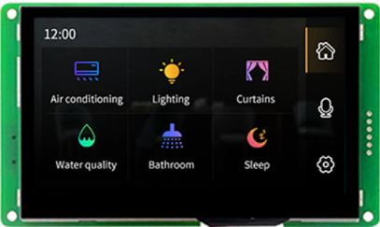


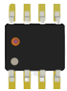
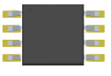
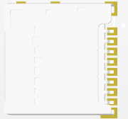

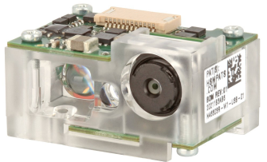
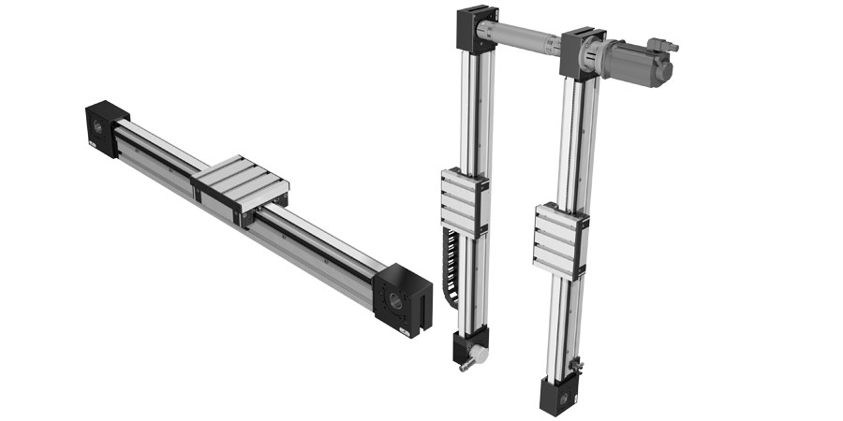
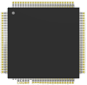
Architecture Diagram (Main Control)
USB
Ethernet
Biosensor (NS01B)
Display
LCD + Touch Panel
Interface
NOR
Flash
TF Card
MCU(Micro Control Unit) ARM Cortex M3 32bit
FEA(Front End Amplifier)
Memory
MCU
Barcode Scanner
Motion System

Slide 5
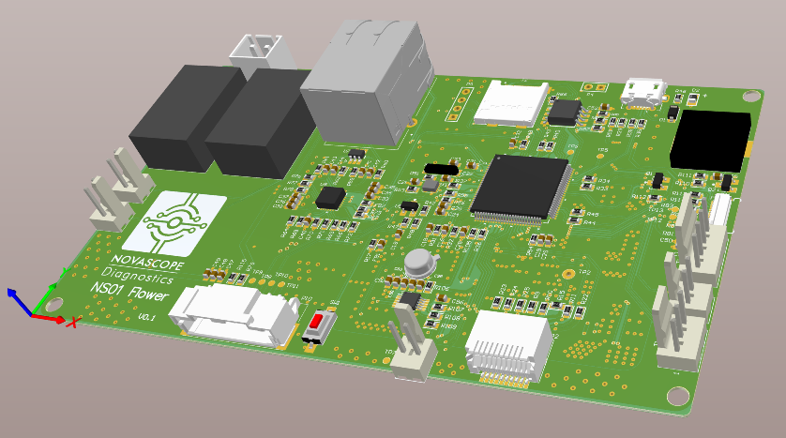
Main control board

Slide 6

Auto-Machine Dimension (Draft)
Dimension: 300mm W x 200mm D x 250mm H
Weight: 3~4KG

Slide 7
Auto-Machine Specifications
Power Supply (Main Power) | 100~240VAC 50/60HZ for motion parts
Power Supply (Sub Power) | DC12V 1A for Flower system operation
Operating environment | Indoor use 10℃~40℃ 10% ~ 60% RH(with condensing) 0m(1.01bar) ~ 2000m(0.763bar) IP 20
Storage environment | 10℃~40℃ 10% ~ 60% RH(with condensing) 0m(1.01bar) ~ 2000m(0.763bar)
For safety, the power supply must be an isolated power system

Slide 8
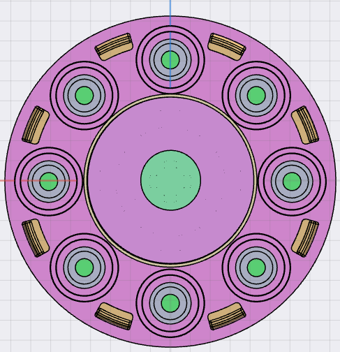
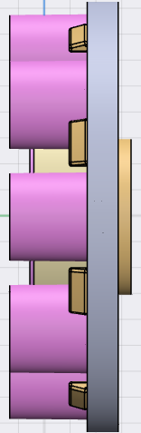
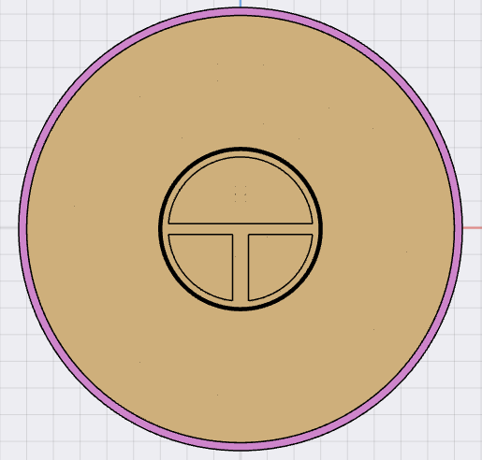
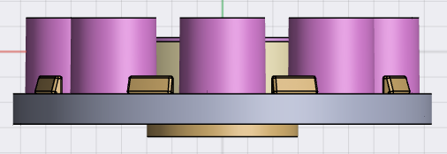
Cartridge Drawing

Slide 9
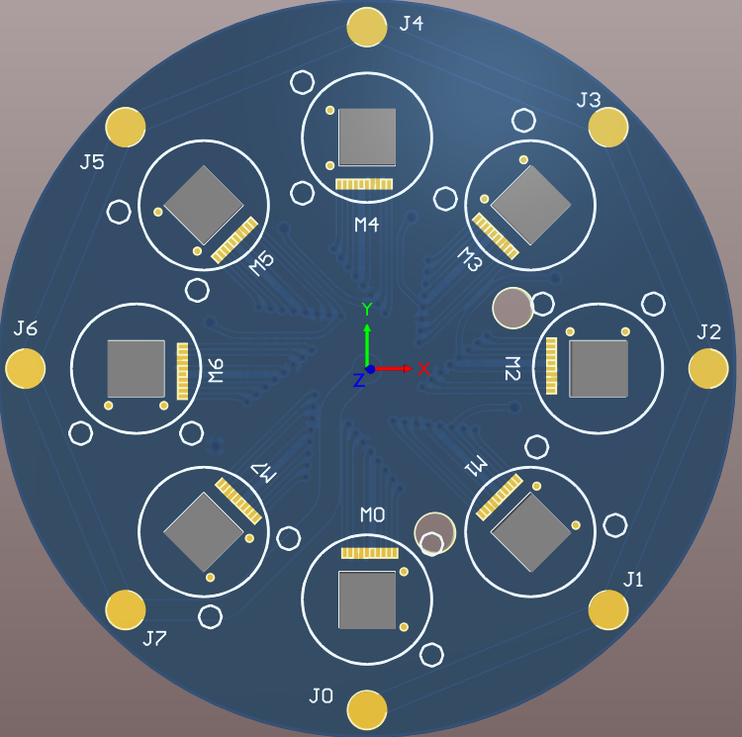
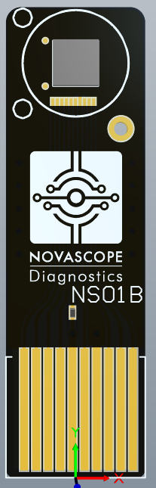
Sensor PCB
8 Chips
1 Chip

Slide 10


